Slide 1
Adaptive Bit Rate
  Doug Keltz
  Doug.Keltz@Tektronix.com
  678-296-5073

Slide 2
Why Adaptive Bitrate Streaming?
Consumers expect content
everywhere and on anything
they own.
How do we accomplish this?

Slide 3
What is Adaptive Bitrate Streaming ?
Deliver content to a variety of device types
Bandwidth is the unknown factor
The client side player determines available bit rate and requests the appropriate content to meet current bandwidth availability
Streams are setup to “adapt” to available bandwidth
As client side bandwidth availability changes, quality can increase or decrease. All the while, continuously delivering content

Slide 4
The Shift to HTTP-Based Delivery
There is now something of shift away from classic streaming protocols towards HTTP
HTTP-based media delivery has little to no firewall restrictions because firewalls and routers regularly pass HTTP through port 80
HTTP media delivery doesn't require special proxies or caches. An ABR file is just like any other file to a web cache server
Networking equipment also doesn’t need to know/understand video. It sees ABR traffic as simple web activity.

Slide 5
What Adaptive Streaming Technologies are available ?
There are two fundamental types of adaptive streaming technologies available
  Non-segmented/fragmented such as H.264/SVC (Scalable Video CODEC)
  Segmented/Fragmented such as
    Apple Live Streaming (HLS) - most popular
    Microsoft Smooth Streaming
    Adobe Flash Dynamic Streaming - least popular
    DASH - new unified standard
Most operators are adopting segmented/fragmented adaptive streaming technologies – primarily HLS with plans to move to DASH
A few operators are hedging by offering streams using two or three major segmented/fragmented technologies
Notes:
DASH is new unifying standard to pontially replace existing standards but for now they can all work using DASH
Apple is every 10 seconds
Adobe and MS is every Two Seconds

Slide 6

Segmented/Fragmented
Files must be “fragmentable”
  H.264 video needs periodic IDR (Instantaneous Decoder Refresh) frames
  No frame after an IDR frame can reference any frame before it
  Each fragment must begin with an IDR frame
Unacceptable picture quality for lower bitrates
  Blockiness and other compression artifacts reduce the perceptual video quality of the program content
  Picture Quality Analysis tools can be used to “tune” the encoder to the best possible quality for a given target bitrate
IDR
P
B
I
Notes:
IDR B B P B B I

Slide 7
MPEG DASH - Dynamic Adaptive Streaming over HTTP
DASH is a standard for adaptive streaming over HTTP that has the potential to replace existing proprietary technologies like Microsoft Smooth Streaming, Adobe Dynamic Streaming, and Apple HTTP Live Streaming (HLS).
Unified standard would be a boon to content publishers, who could produce one set of files that play on all DASH-compatible devices.
Other advantages
  Codec-independent
  Does not specify a DRM method (supports all DRM techniques specified in ISO/IEC 23001-7: Common Encryption)
  Trick modes for seeking, fast forwards and rewind
  Dynamic advertising insertion
Notes:
IDR- like I frame to clear buffer and not look beyond this frame. Instantaneous Decoder Refresh
DRM = Digital Right Management
Manifest files track what is in file.

Slide 8
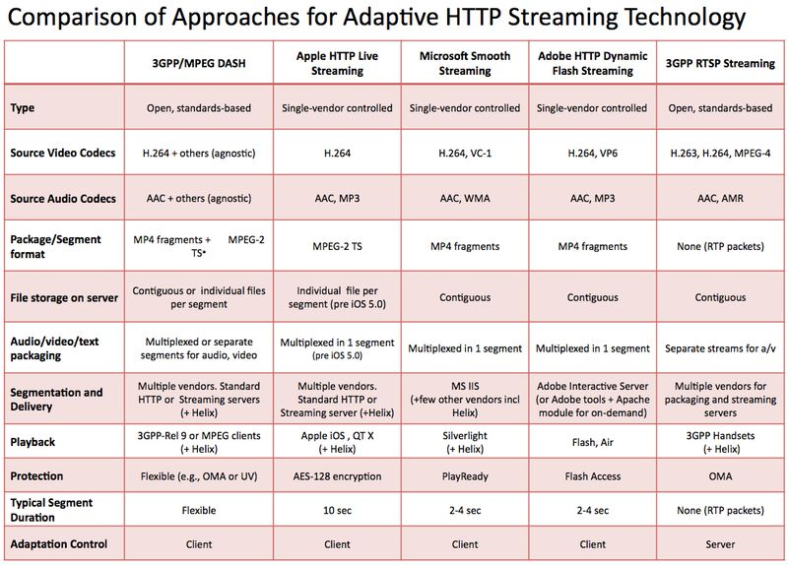

Slide 9
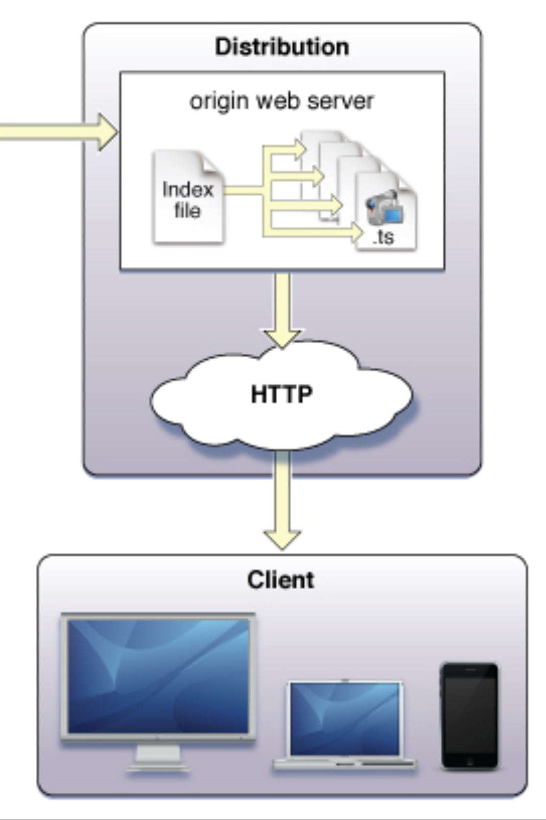
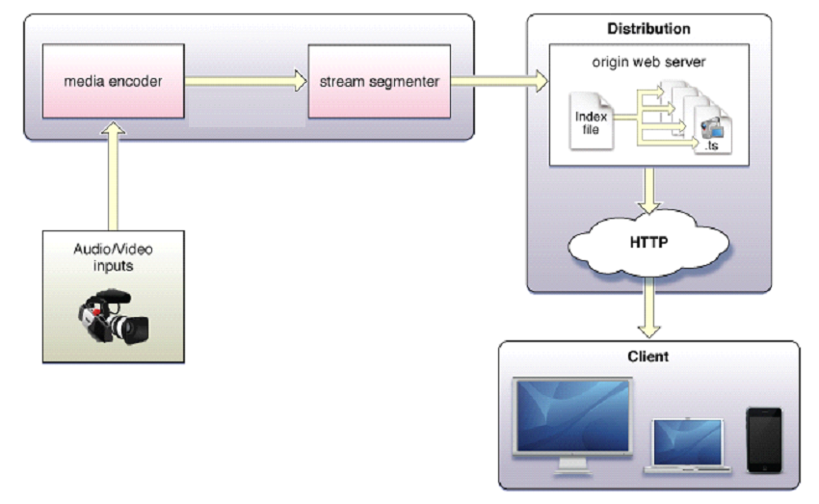
Linear Adaptive Streaming Simplified Architecture
Master
Encoders
Transcoders
Fragmenters
(Apple, MS, Adobe)
Origin Server
Multiple copies at different bit rates (1-16 copies)
Same content split in to small 2 to 10 sec. files (fragments)
Notes:
Apple is every 10 seconds
Adobe and MS is every Two Seconds

Slide 10
ABR Profiles
Video Transcoding
Transcode the input to each required output profile – where a given profile will have its own resolution and bit rate parameters – including scaling to resolutions suitable for each client device.
Because the quality of experience of the client depends on having a number of different profiles, it is necessary to encode a significant number of output profiles for each input. Deployments may use anywhere from 4 to 16 output profiles per input.
 | Width | Height | Bit rate
 | 1280 | 720 | 3 Mbps
 | 960 | 540 | 1.5 Mbps
 | 864 | 486 | 1.25 Mbps
 | 640 | 360 | 1.0 Mbps
 | 640 | 360 | 750 Kbps
 | 416 | 240 | 500 Kbps
 | 320 | 180 | 350 Kbps
 | 320 | 180 | 150 Kbps

Slide 11
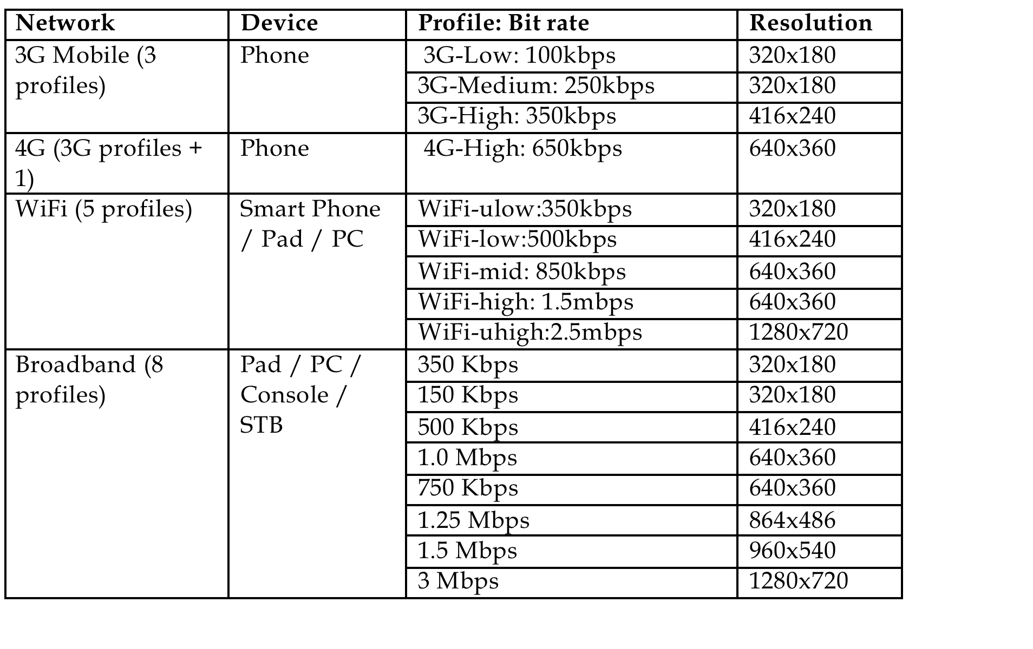
Example Profile Bit Rates by Device Type

Slide 12
Walk me through the initial process
Customer Client
Content Proxy
Edge Cache
Origin Cache
Hello! Here is my sub id, device type, bandwidth available, session ID.
I would like Superman 3, please.
Authentication
Do I have the asset?
Sub id, device type, bandwidth available, and session ID would like Superman 3, please
Yes
No
Send manifest file (XML)
Request asset file
Transfer file to Edge Cache
Process manifest file
Profile 2 of Superman 3, to session ID, please
Profile 2 of Superman 3, to session ID, please
Transfer file segment
Here is your file, enjoy
Here is your file, enjoy
Measure download speed and begin playback

Slide 13
What happens with available bandwidth changes?
Customer Client
Content Proxy
Edge Cache
Origin Cache
Measure download speed from last file
Examine manifest file and determine best profile
Here is my session ID.
Profile 6 of Superman 3, please
Profile 6 of Superman 3, to session ID, please
Transfer file segment
Here is your file, enjoy
Here is your file, enjoy
Measure download speed from last file
Examine manifest file and determine best profile
Repeat process until asset is finished or customer stops playback

Slide 14


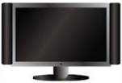
Sentry Multi-Screen Video Network Quality Assurance
Medius
Element Mgmt. Control,
& Roll-up report
Sentry
Sentry
Sentry ABR
Sentry ABR
Video Monitoring
Over UDP/RTP
Video Monitoring
Over UDP/RTP
Video Monitoring
Over HTTP
Video Monitoring
Over HTTP
Computer
Live or VOD Content
Transcode
Fragment & DRM
Origin Server
CDN
Smartphone
Tablet
ABR Video Preparation
ABR Video Distribution
QoE – Decodeability
PVQ - Artifacts
Audio Loudness
SCTE35
QoE – Decodeability
PVQ - Artifacts
Audio Loudness
EBP/IDR – Q4
Profile availability
Packet strucutre
Packet rate
Manifest file verification
TV

Slide 15
Network and Troubleshooting Overview

Slide 16

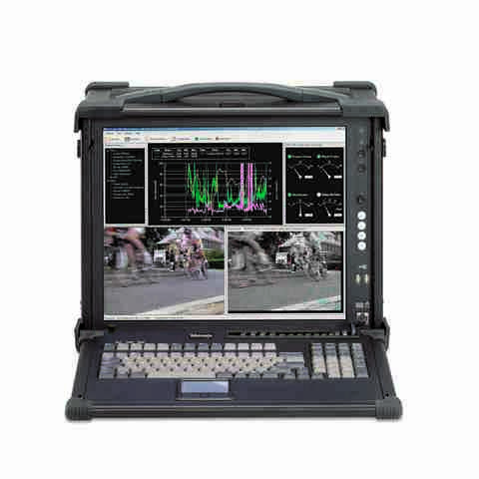
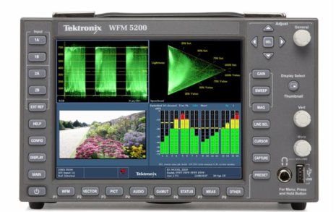
Where to Monitor and Test
Medius
Sentry
Sentry Verify
Sentry
Sentry Verify
iPad
Sentry
Sentry
Sentry Edge II
Computer
Source Content
Receiving
Video Processing
IP Transport
Video Processing
Modulation
HFC
Access Network
CDN, Last Mile
Linear or VOD
TS over
RF/IP/ASI
Transcoding
Muxing
Rate-Shaping
(Encrypt)
1G or 10G
Optical/Copper
Muxing
Splicing
Rate-Shaping
Smartphone
QAM
TV
MTS-4000
WFM-5250
Notes:
16

Slide 17
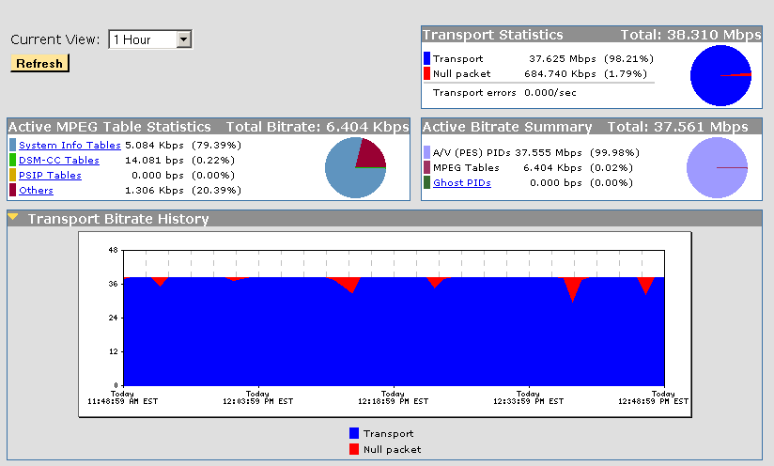
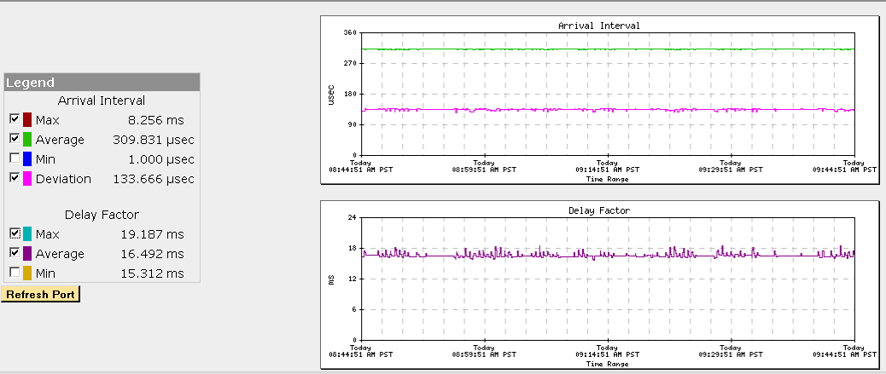
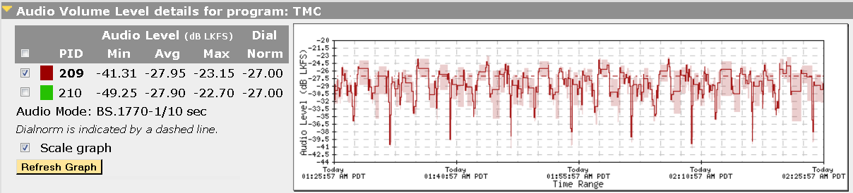
What to Monitor
Operational Concerns
IP Network Performance
TS Performance
Audio Level Compliance

Slide 18
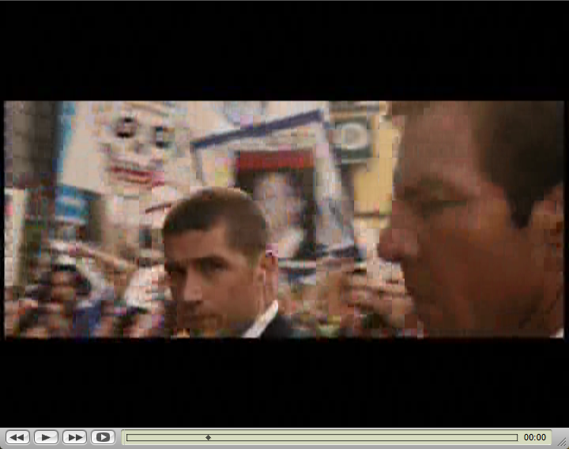
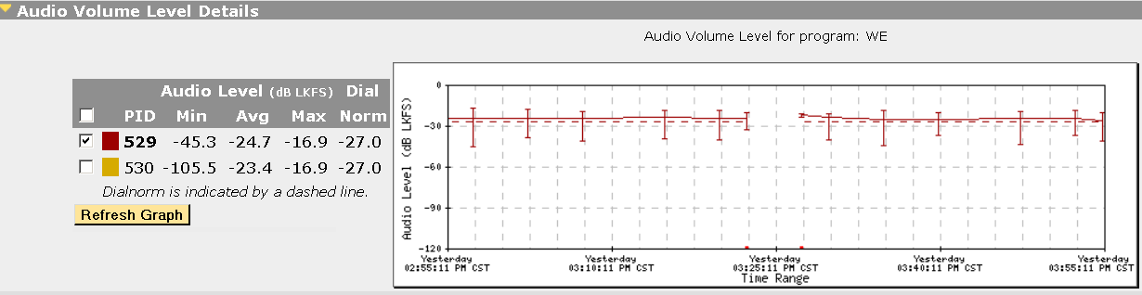
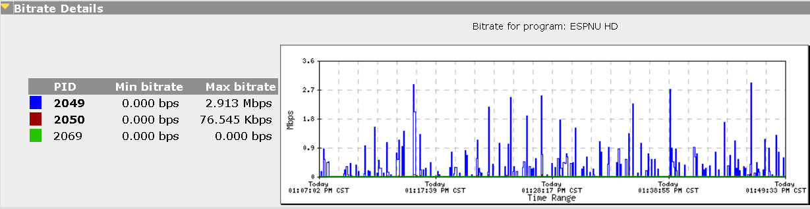
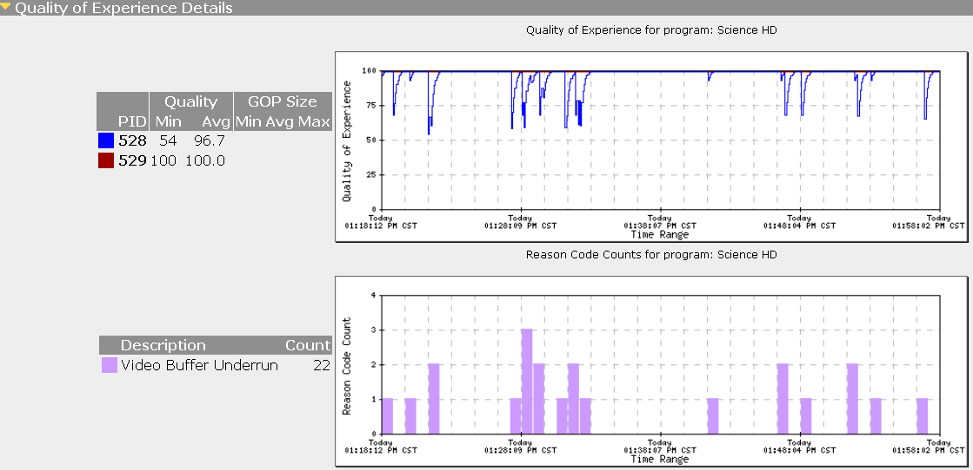
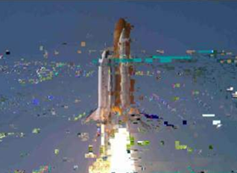

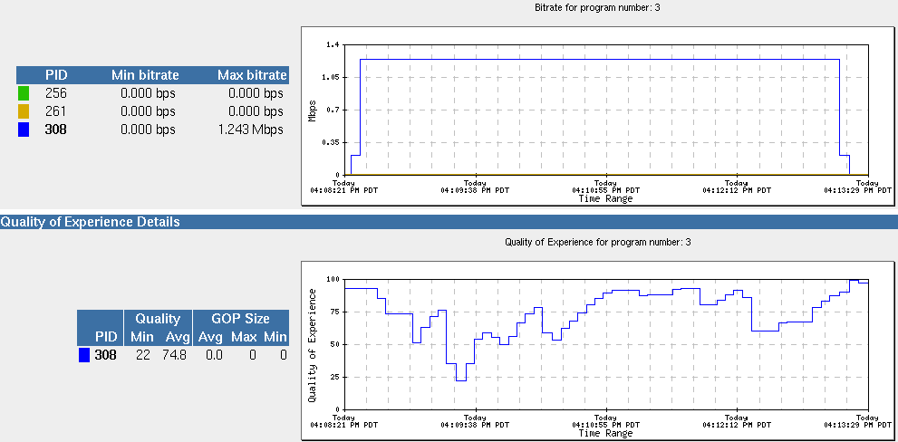
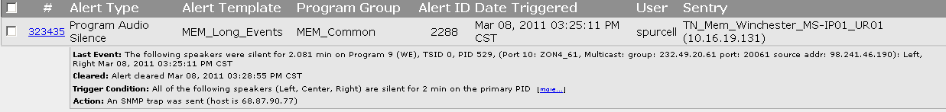
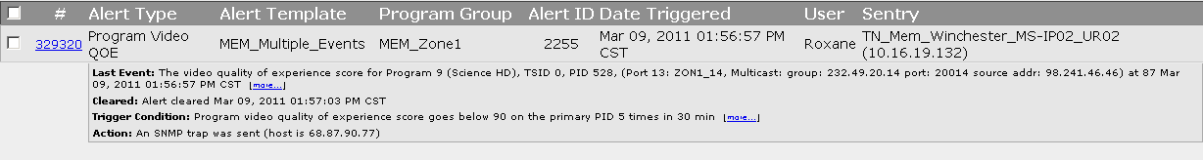
What to Monitor
Customer Impacting Issues
Video Freeze / Black
Audio Silence
Blocking / Tiling (Video QOE)
Blurred / Soft Picture
(Preceptual Quality)
Program Unavailable

Slide 19
Troubleshooting
Troubleshooting video signals in a broadcast or cable facility requires the use of an MPEG Analyzer that provides multiple input signals all running in parallel.
Critical capabilities in an MPEG Analyzer should include:
Transport stream generation, modification and analysis
  Real and deferred time
  Including MPEG-2, H.264 & MPEG-4 AAC
  Multiplexer
  Automatic error triggered recording and capture
A range of physical interfaces
  Multi-port ASI
  RF (DVB-S2, 8-VSB & QAM-B)
  Video over IP analysis and generation (1G and 10G)
Comprehensive suite of software tools for analyzing all layers of video
  High accuracy RF layer analysis
  Transport, Program & Elementary Streams
  Video & Audio Quality of Experience (QoE)
  Picture Quality
Notes:
Troubleshooting video signals in a broadcast or cable facility requires the use of an MPEG Analyzer that provides multiple input signals all running in parallel.
Critical capabilities in an MPEG Analyzer should include:
Transport stream generation, modification and analysis
Real and deferred time
Including MPEG-2, H.264 & MPEG-4 AAC
Multiplexer
Automatic error triggered recording and capture
A range of physical interfaces
Multi-port ASI
RF (DVB-S2, 8-VSB & QAM-B)
Video over IP analysis and generation (1G and 10G)
Comprehensive suite of software tools for analyzing all layers of video
High accuracy RF layer analysis
Transport, Program & Elementary Streams
Video & Audio Quality of Experience (QoE)
Picture Quality

Slide 20

Quality of Service (QOS)
Buffer Over-Run
Monitor, TV, etc
IP
Small
Inter-Packet Gap
MPEG Packets
MPEG
Inter-Packet Gap
Buffer
(Removes Ethernet frame and buffers MPEG)
Key Measure – Dropped Packets
  IP switches can occasionally drop packets.
  Most video over IP uses UDP (no retransmission)
Decoder
  With MPEG-2 transport packets, continuity counters help identify dropped packets.
  Counting lost packets at the IP layer is not too helpful as each missing packet will usually generate audio or video degradation.
Notes:
IP Video Key Measures – Dropped Packets
Given the complexity of IP switches, occasional failures or overloads do occur and cause IP packets to get dropped.
Most video over IP uses UDP (send and forget) – so we need another method to know when an IP packet has been lost.
With MPEG-2 transport packets, each TV program includes separate 4-bit counters for each audio and video element, so it is possible to determine when a packet might have been dropped.
Calculating the ratio of missing packets to total packets is possible, but not too helpful as each missing packet will usually generate audio or video degradation.

Slide 21
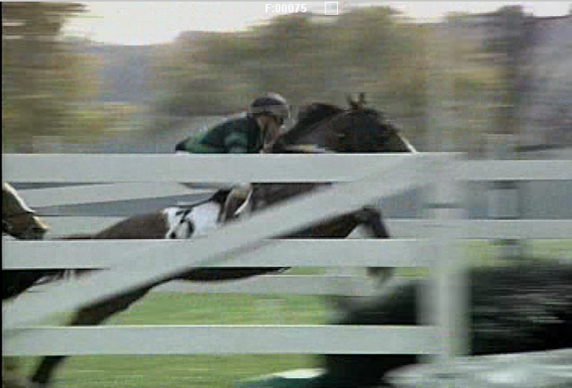
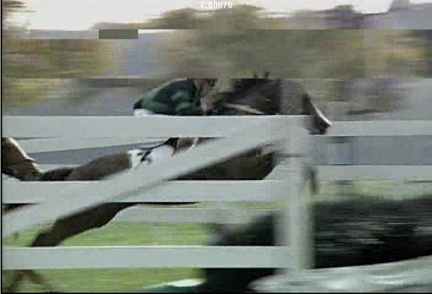
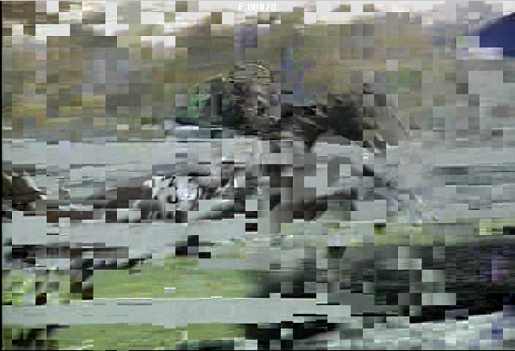
Quality of Experience (QOE)
Compressed Video is not “linear” because different frames have different importance and an error in an I-frame may reside on the TV screen for an entire Group of Pictures (about 500 ms).
With a bad B-frame picture, it only stays on the TV screen for one frame (1/30th or 1/25th of a second).
A bad bit could cause an entire slice or row of pixels to turn green.
Major Errors Caused
By Corruption of Following
I-Frame
No Errors
Slice Error
I
B
B
B
P
B
B
B
P
B
B
B
P
B
B
B
P
Notes:
To measure the QoS of the MPEG-2 transports, TR 101 290 is sufficient.
Determining the quality of the audio and video (QoE) will require much more processing than simply looking at MPEG transport packet headers and packet gaps.
Given that compressed TV is not linear like uncompressed audio, a bad bit landing in the middle of an MPEG video I-frame is much worse than a bad bit landing in the corner of a B-frame.
The reason that this issue is not considered linear is because an error in an I-frame may reside on the TV screen for an entire Group of Pictures (about 500 ms).
With a bad B-frame picture, it only stays on the TV screen for one frame (1/30th or 1/25th of a second).
Also, a bad bit could cause an entire slice or row of pixels to turn green. Or maybe the bad bit only causes a signal pixel to change color.
We need to keep track of impairments within each audio and video element.

Slide 22
QOE Reason codes
Missing Video Slice
  A particular video slice (horizontal row of macroblocks) was expected but not found. A special case of Video Syntax Error
Unexpected Video Header
  The state following the decode of a video header was unexpected. Special case of Video Syntax Error.
Video Syntax Error
  An unexpected state occurred while decoding video slice data.
Video Packet Loss
  A Continuity Count error (a.k.a., discontinuity) is detected at the same time there is a video PID bitrate dropout of a short duration (< 200 ms)
Video PID Dropout
  A long video PID bitrate dropout occurred (> 200 ms). (may or may not be accompanied by a CC error, see "Note 2" for details.)
Video Buffer Underrun
  A video frame's DTS value was >= the current PCR resulting in a (decode) buffer underrun.
Video Buffer Overrun
  A video frame's DTS value was > 3 seconds for MPEG-2 or > 5 seconds for H.264 behind the current PCR resulting in a decode buffer overrun.
Compression artifacts inclusion
  When PVQ score reduced by 20% or more in 5 seconds

Slide 23
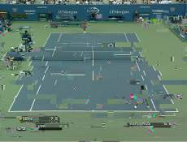
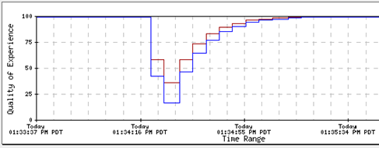
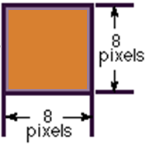
QOE or PVQ
Video PID (MPEG packet)
Group Of Pictures
.
.
.
Picture
QoE =
MPEG structural errors
Slice
Macroblock
PVQ =
Compression artifacts
Block

Slide 24
Troubleshooting Examples

Slide 25
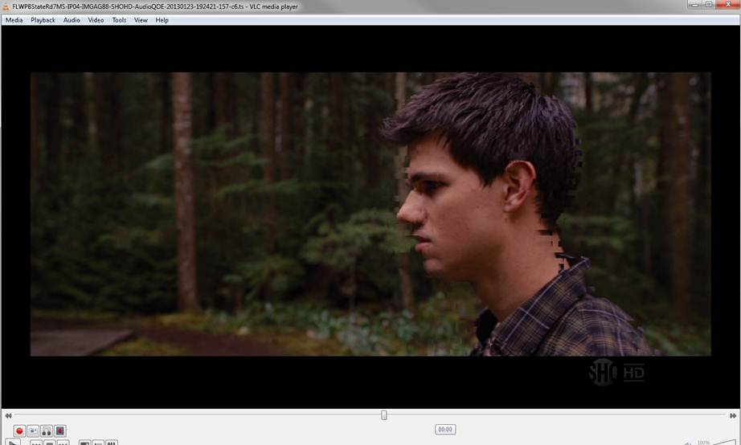
Buffer Underrun Issue
Problem: Customer complaining about blocking and tiling. Operations receiving QOE Alerts.
Playback of captured video shows blocking around the head if image.

Slide 26
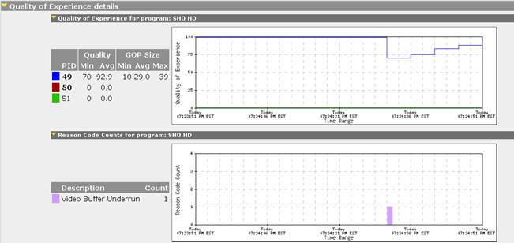
Buffer Under run Issue
Problem: Customer complaining about blocking and tiling. Operations receiving QOE Alerts.
Sentry shows low QOE Score (70) and identifies the issue as Buffer Under run.

Slide 27
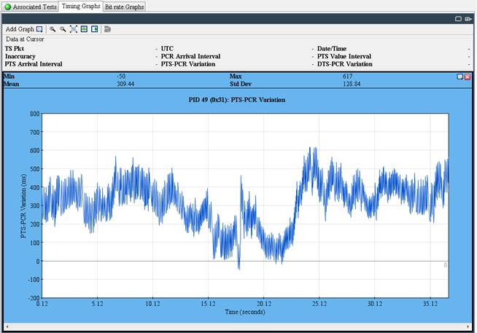
Buffer Under run Issue
Problem: Customer complaining about blocking and tiling. Operations receiving QOE Alerts.
Analysis with the MTS-4000 (TSCA Software) shows PTS-PCR going below 0 (under run).
Under normal operation the PTS-PCR variation should never go below 0. Anytime 0 is reached or negatively exceeded then there is a buffer underrun condition which can cause problems.
Re-grooming the mux corrected the problem.

Slide 28
Transport Packet Header
Discontinuity Issue
188 Bytes
Header Payload
Minimum 4-byte header
^{Sync}
^{Byte}
⁸
^{Transport}
^{Error}
^{Indicator}
¹
^{Start}
^{Indicator}
¹
^{Transport}
^{Priority}
¹
^{PID}
¹³
^{Scrambling}
^{Control}
²
^{Adaptation}
^{Field}
^{Control}
²
^{Continuity}
^{Counter}
⁴
^{Adaption}
^{Field}
^{Payload}
^{Adaptation}
^{Field}
^{Length}
⁸
^{Discontinuity}
^{Indicator}
¹
^{Random}
^{Access}
^{Indicator}
¹
^{Elem Stream}
^{Priority}
^{Indicator}
¹
^{5 Flags}
⁵
^{Optional}
^{Fields}
^{Stuffing}
^{Bytes}
^{PCR}
⁴⁸
^{OPCR}
⁴⁸
^{Splice}
^{Countdown}
⁸
^{Transport}
^{Private}
^{Data}
^{Adaption}
^{Field}
^{Extension}
Notes:
Each transport packet has a minimum 4-byte header and a maximum 184-byte payload,
Key data in the minimum header are the Sync Byte and the PID (packet identification).
PID values are 13 bits giving them a range of 0 to 8191. Only 0, 1, and 8191 are assigned by the MPEG standard.
Program timing information is carried by the PCR (program clock reference) which is in the optional fields of the adaptation field of some transport packets.
Some other fields of interest:
continuity_counter: a 4 bit field that counts through 16 values on a “per-pid” basis. Discontinuities are only allowed in particular situations. This field is used to determine lost or repeated packets.
discontinuity_indicator: indicates both a timebase discontinuity and a continuity counter discontinuity.
random_access_indicator: indicates that the next PES packet to start in this PID stream contains a video sequence header or the first byte of an audio frame.
splice_countdown: an 8 bit field specifying the number of packets, of the same PID value, before a splice point. Hence, a splice point is reached when this field has a value of 0. This packet contains the last coded byte of a picture or audio frame. The next TP of the same PID must contain the start of a new PES packet and that PES packet payload must begin with a video sequence header or the start of an audio frame.

Slide 29
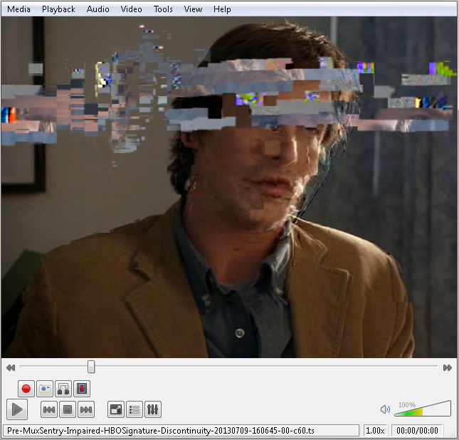
Discontinuity Issue
Problem: Customer complained about continuous tiling for program.
Capture played back shows blocking across top of screen.

Slide 30
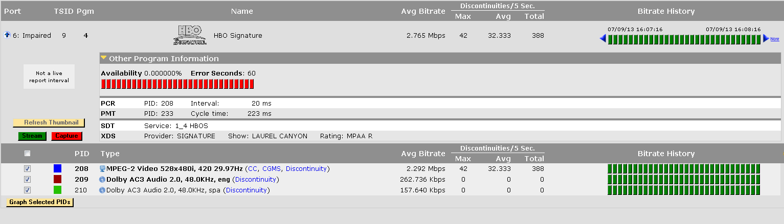
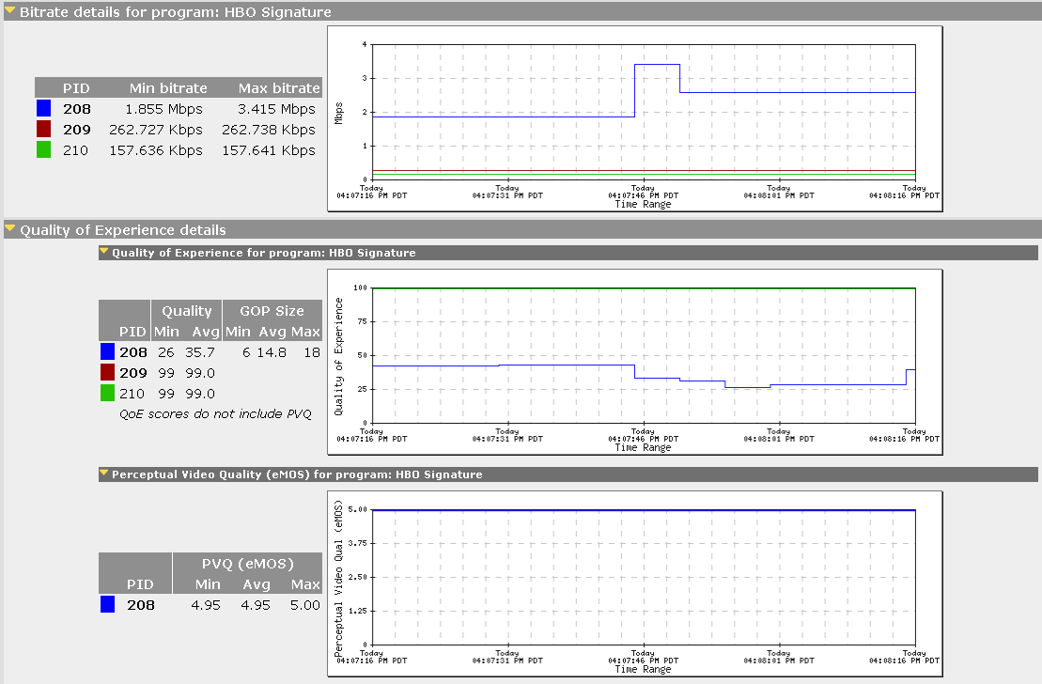
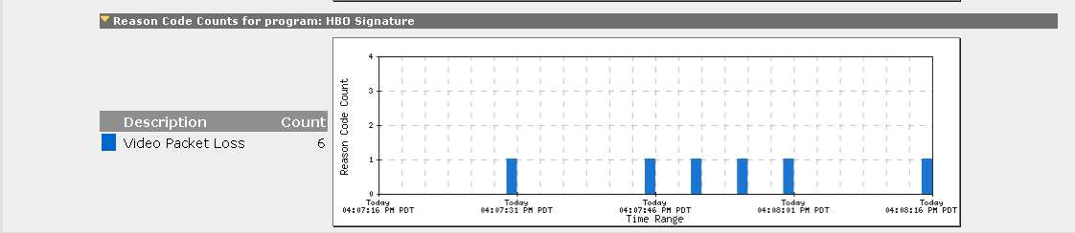
Discontinuity Issue
Problem: Customer complained about continuous tiling for program.
Monitoring system alerted on low QOE score due to ‘Video Packet Loss’.

Slide 31
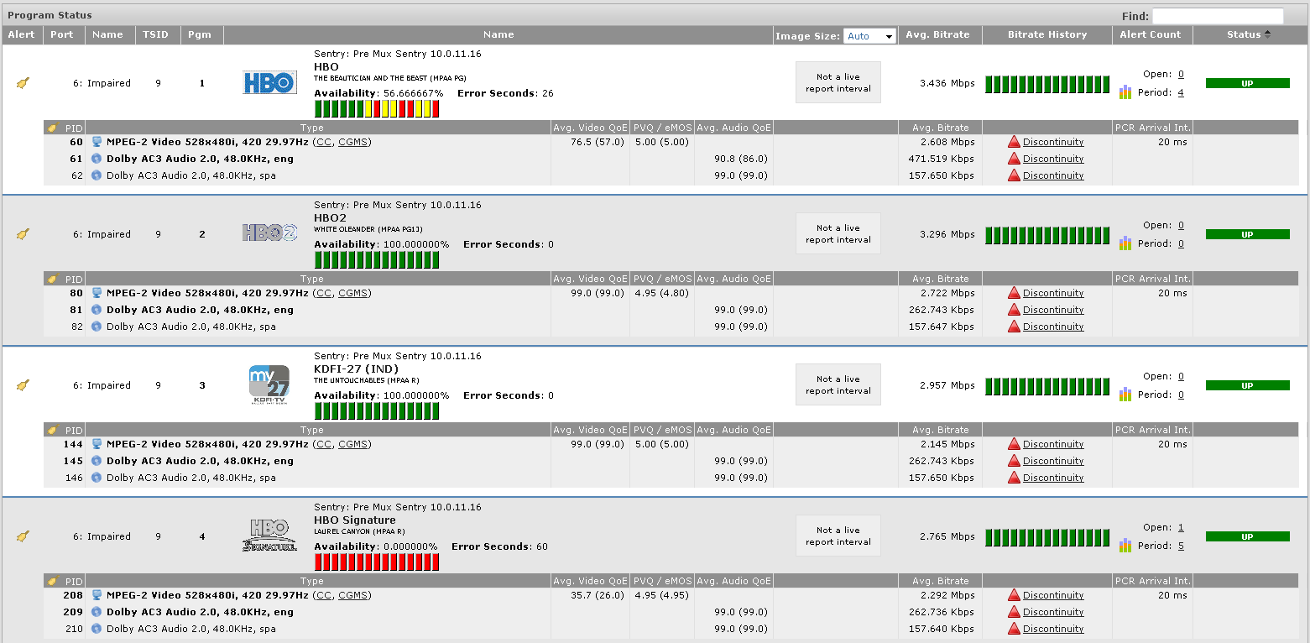
Discontinuity Issue
Problem: Customer complained about continuous tiling for program.
Looking at the Transport Stream Status View, we see all programs are experiencing Discontinuities.

Slide 32
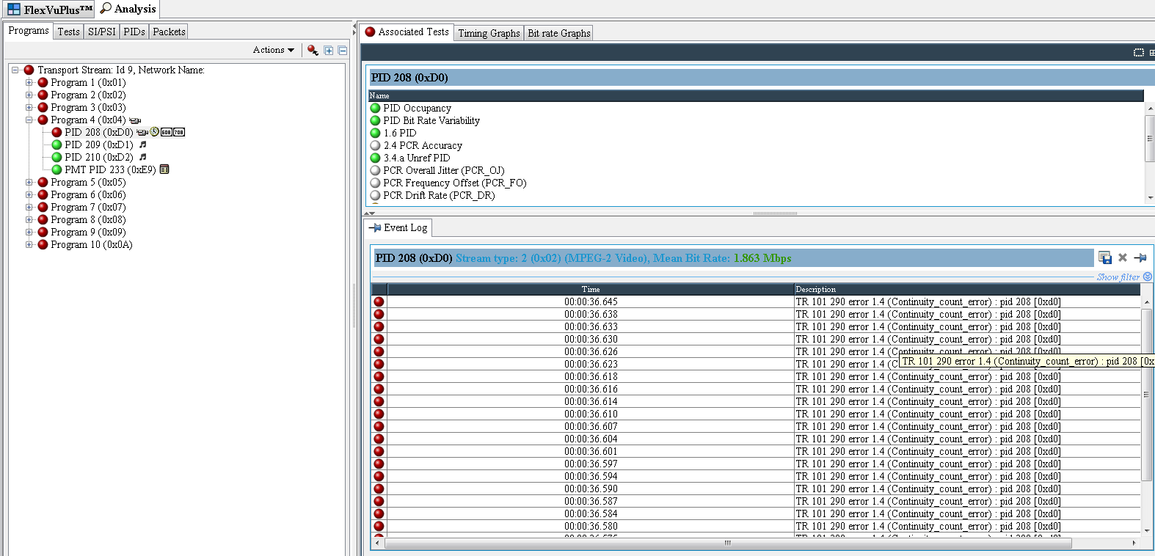
Discontinuity Issue
Problem: Customer complained about continuous tiling for program.
Analysis with the MTS-4000 (TSCA Software) shows continuous Discontinuity for Video PID.

Slide 33
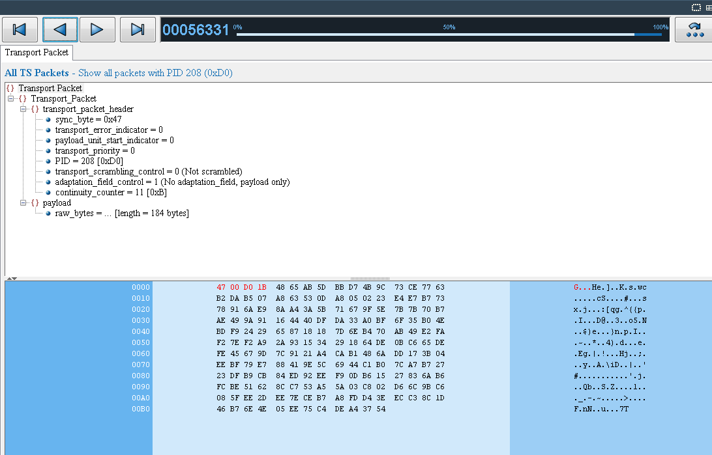
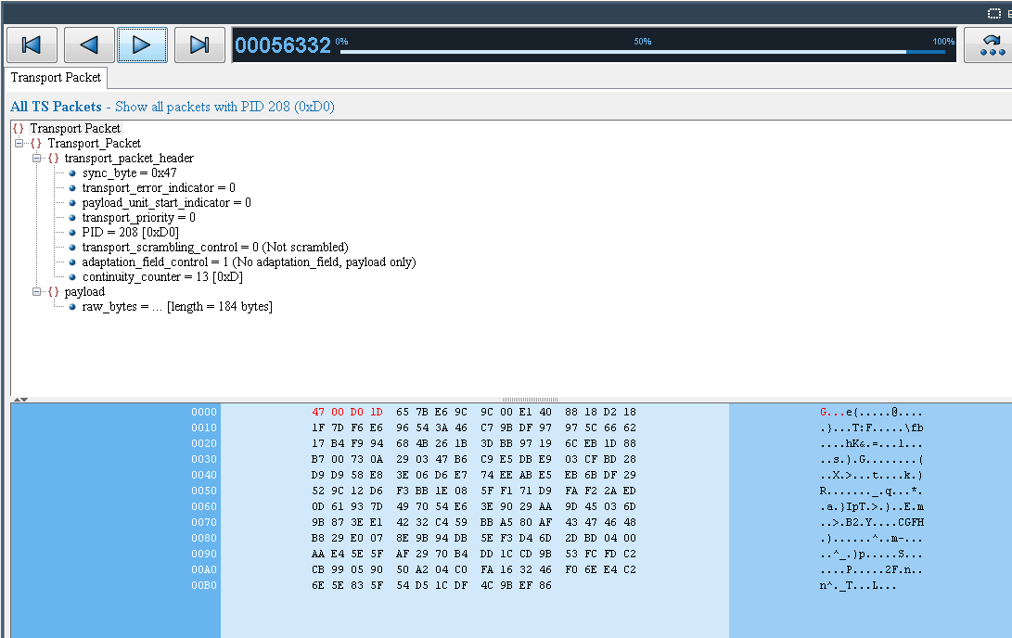
Discontinuity Issue
Problem: Customer complained about continuous tiling for program.
Analysis with the MTS-4000 (TSCA Software) shows continuous Discontinuity for Video PID, drilling into the packet view shows missing packet (12).

Slide 34

















Discontinuity Issue
Content Processing
Browse/Lo-Res
Proxy
Ingest
Edit
Metadata
Graphics
VoD Server
Content
Grooming
SD-SDI, HD-SDI, 3G-SDI
Monitoring Need:
Video errors and compliance
Audio errors and compliance
Audio Loudness
Closed Caption and Metadata Errors
Web Server
Transcode
Telecom/3GPP
Provider
ASI, IP, RF
Central
Storage
Monitoring Need:
Encoder quality
Post mux video and audio QoE
IP and TS structure errors
Splicing, EBI, tru2way Errors
HD Encode
ESPN1
Splice, Encrypt
Modulate
Filebased Formats
Monitoring:
Video QoE and Video Codec Errors
Audio QoE and Audio Codec Errors
File Wrapper structure
Loudness monitoring and correction
MCR
ESPN2
SD Encode
Presentation Control
Adaptive Bit Rates and Streaming
Monitoring:
Profile availability
Packet structure
Packet rate
Manifest file verification
Local Content and Ads

Slide 35
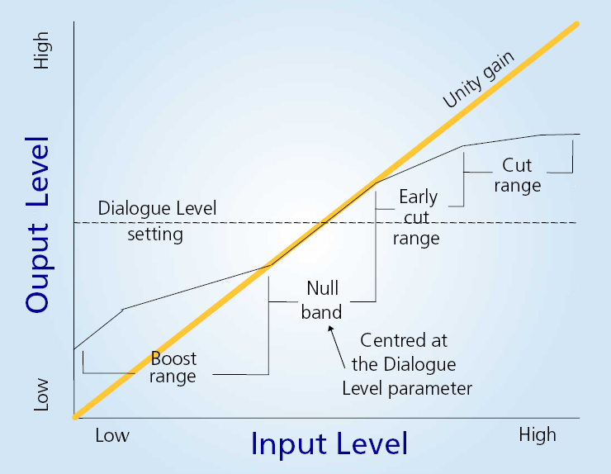
CALM Act Issue
Problem: Customer complained loud commercials.

Slide 36
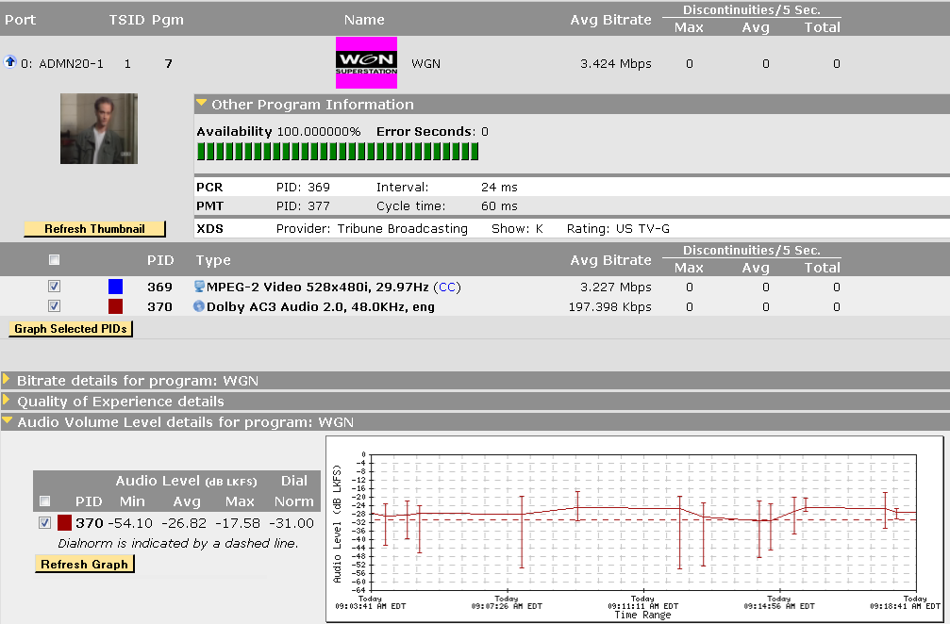
CALM Compliance
Problem: Customer complained loud commercials.
Circled area represents entire Ad segment. The entire graph represents a 15 minute of time. The thumbnail to the left represents the current active content. Leading into the commercial, the program content had the same type of level changes.

Slide 37
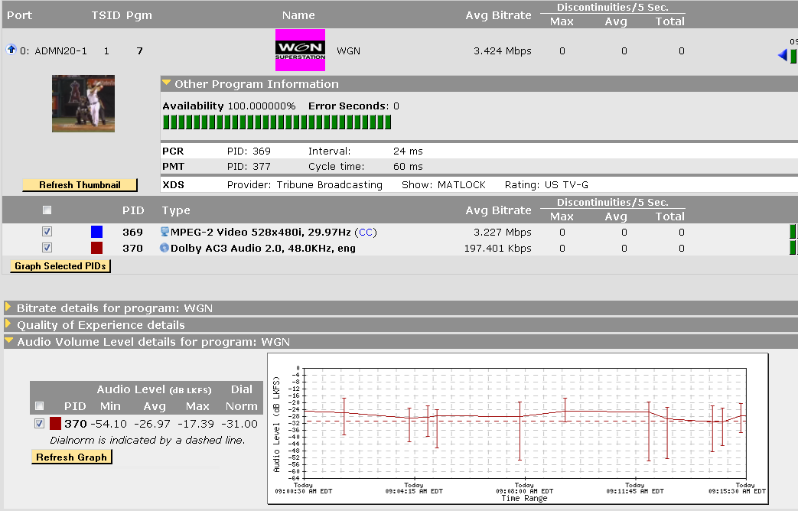
CALM Compliance
Problem: Customer complained loud commercials.
Initial transition into a broadcast (non-adcue) commercial. Ballgame being advertised. Dialnorm at -31 actual audio at -24. Each column/block represents 30 seconds.

Slide 38
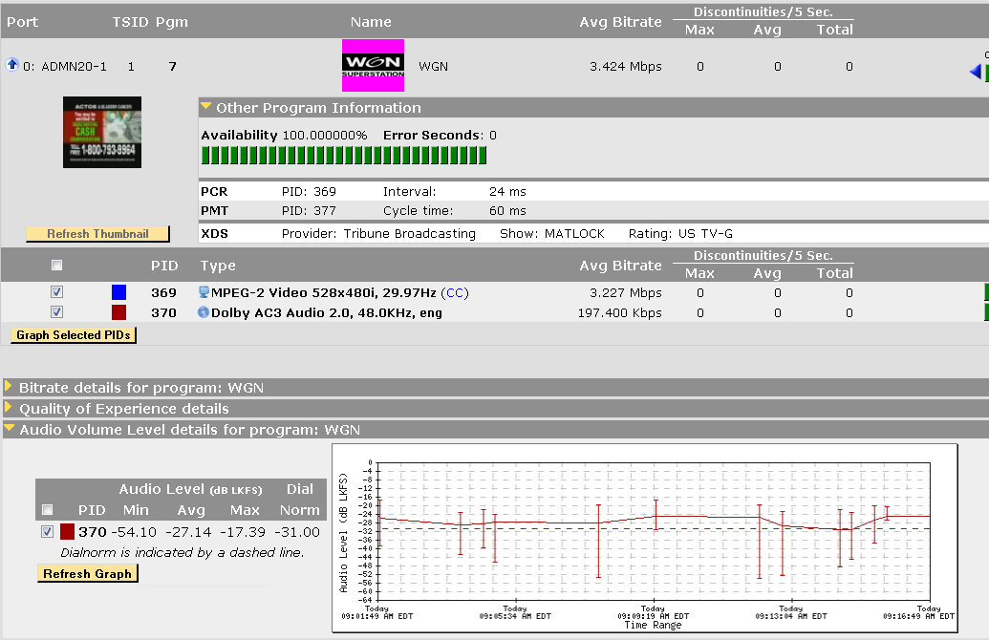
CALM Compliance
Problem: Customer complained loud commercials.
Second (non-adcue) commercial. Cash for Gold being advertised. Dialnorm at -31 actual audio at -24 as with first commercial. Each column/block represents 30 seconds.

Slide 39
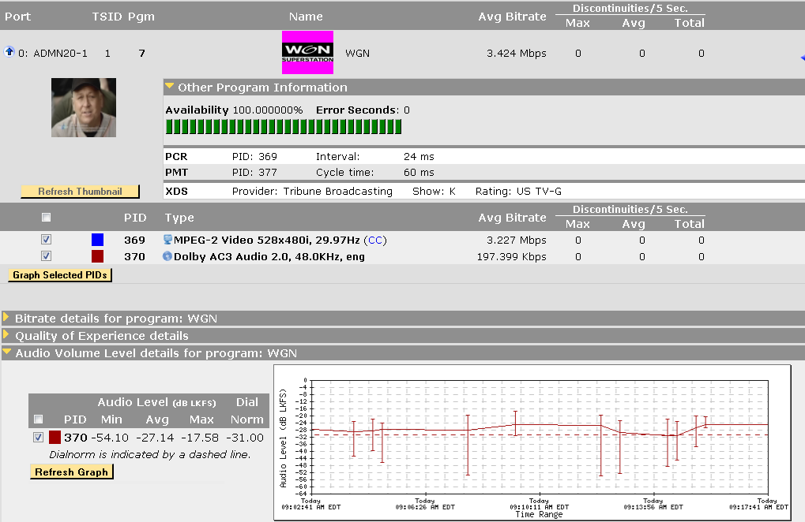
CALM Compliance
Problem: Customer complained loud commercials.
Third (non-adcue) commercial. Cal Ripken being advertised. Dialnorm at -31 actual audio at -24 as with first commercial. Each column/block represents 30 seconds.

Slide 40
Doug.Keltz@Tektronix.com
678-296-5073

